Slide 1


Kettle
Experiment 4
Raphael S. Nano
CPE160P / B1
Computer Engineering Department
School of Electrical, Electronics, and Computer Engineering

Slide 2
Introduction: Kettle
It is a device primarily developed to efficiently and conveniently heat water for various purposes
May be traditional stove-top or modern electric
Demonstrating a real kettle’s automatic feature of turning off after reaching boiling point

Slide 3
Objectives
To be able to demonstrate how a real kettle works.
To be able to apply embedded system in monitoring the boiling point of the water using humidity sensor, an indicator of the boiling point of water using a sound sensor, and turns off the kettle automatically as the water reaches the boiling point using servo motor.
To be able to apply what you have learned in Microprocessor and Logic Circuits and Switching Theory.
To be able to apply an embedded system in a simple handshaking using Arduino Kit.

Slide 4
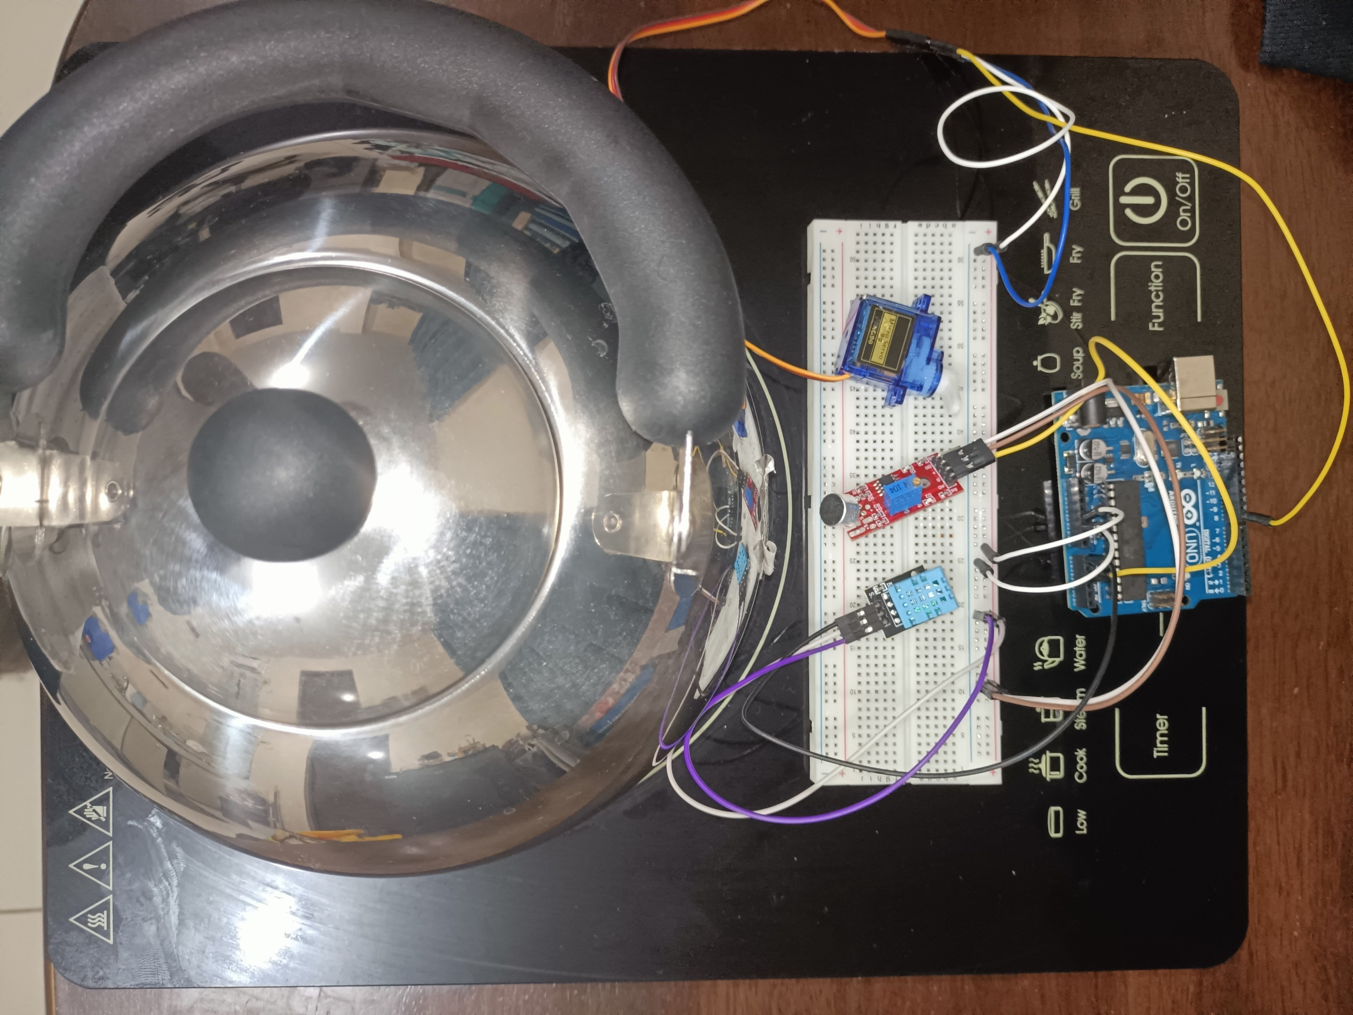
Materials
Arduino Kit
Arduino Uno
DHT11 Humidity and Temperature Sensor
SY-M213 Sound Sensor
SG90 Servo Motor
Kettle
Induction Cooker

Slide 5
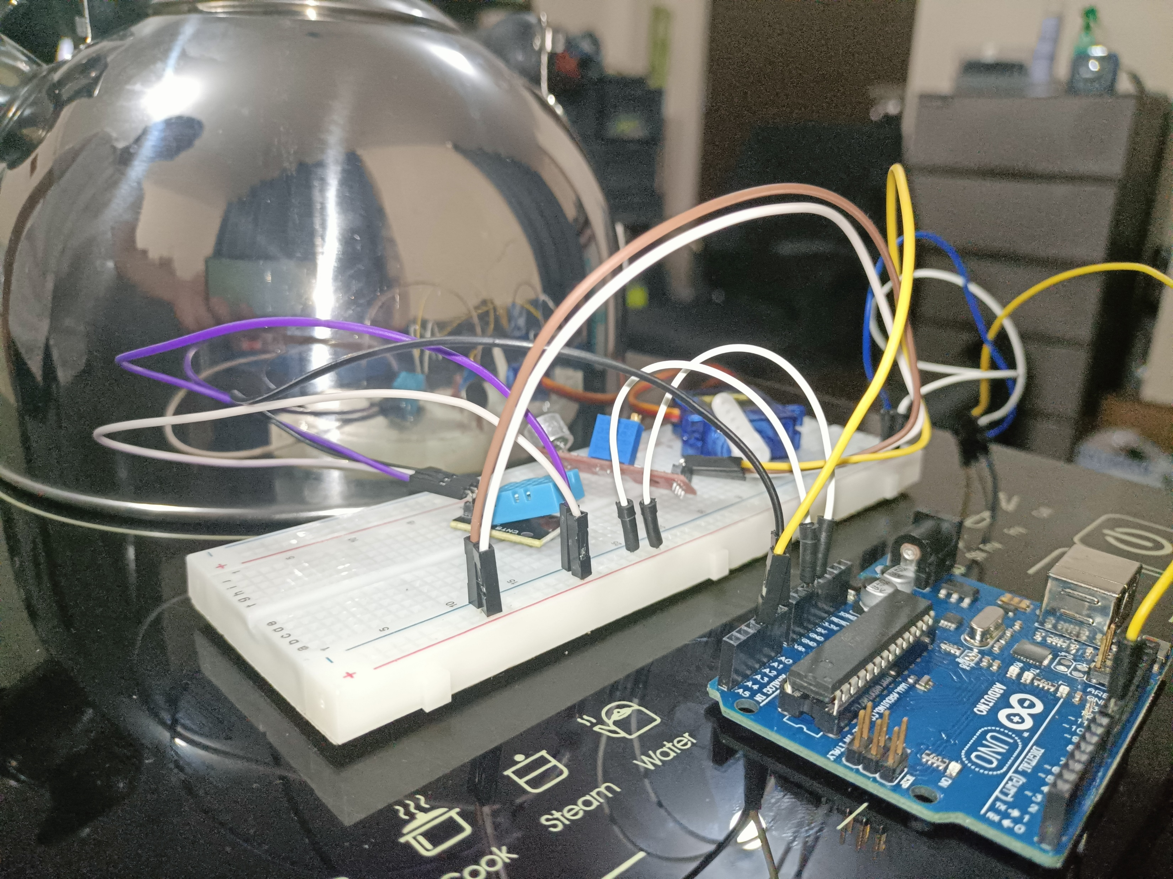

Discussion: Kettle Automation System
The humidity and sound sensor continually detects changes in its environment – steam for humidity sensor and kettle whistle for sound sensor
When both sensors are triggered, the servo motor will rotate
Room humidity % is 30, Room with steam % is 81, Air conditioned room with steam is 60 %.
dht.h and Servo.h external libraries were utilized
Conditions are if humidity percentage reached 60% and if sound sensor detects the whistling sound
Servo Motor rotates from 0 to 180 degrees

Slide 6
Conclusion
A real kettle was demonstrated by showing the automated portion of turning off the heater
By checking the humidity percentage and sound, the motion of the servo motor proves the indication of the boiling point of water
Pin configurations, triggering of sensors, and proving a kettle’s process with an embedded system applied learnings from Microprocessors and Logic Circuits and Switching Theory
A real kettle was produced and demonstrated successfully

